Slide 1
Optimization of Resource Scheduling In Cloud Computing using Particle Swarm Optimization Technique
Hemanth Sivaram – ITE08117
K.Sampath Kumar – ITE08121
Kruthika.M – ITE08128
Goutham Reddy – ITE08136
Praneeth Reddy – CB107IT134
Guide:
Ms Bindu K.R
Asst.Professor

Slide 2
Introduction
The aim of the project is to optimize the resource scheduling in cloud computing using particle swarm optimization.

Slide 3
Cloud Computing
A model for delivering information technology services in which resources are retrieved from the internet through web-based tools and applications, rather than a direct connection to a server

Slide 4
Merits of Cloud Computing
Reduced Cost
Increased Storage
Highly Automated
Flexibility

Slide 5
Types of clouds
Public cloud
In a public cloud applications, storage is made available to general public on the internet.
Private cloud
In a private cloud applications, storage is made available for a single organization.

Slide 6
Resource Scheduling
The scheduling of resources plays a vital role in the cloud environment.
Proper scheduling can lead to effective utilization of the cloud computing environment.

Slide 7
Resource scheduling…
The scheduling algorithm chosen for the project is Best Resource Selection (BRS) Algorithm.
BRS schedules resources based on the Environmental utilization time.

Slide 8
Optimization Of Resource Scheduling
There are many optimization techniques available out of which
ACO
PSO
are more popular and efficient techniques in distributed computing.

Slide 9
Comparison
Ant Colony optimization | Particle Swarm Optimization
The ACO is inspired by the aging behaviours of ant colonies | The PSO technique modelled on the social behaviours observed in animals or insects
ACO is more applicable for problems where source and destination are predefined and specific | PSO is a clustering algorithm in the areas of mutliobjective, dynamic optimization and constraint handling
ACO is more applicable for problems that requires crisps results | PSO is applicable for problems that are fuzzy in nature

Slide 10
Comparison...
Based on the comparison, the Particle Swarm Optimization Technique is considered.

Slide 11
SEQUENCE DIAGRAM
Sequence diagram.rtf
archi.docx
Architecture Diagram

Slide 12
System Simulation
The server and client are connected through wireless LAN.
LAN connection is created in the server side with unique IP address.
The connection is made public.

Slide 13
System Simulation. . .
A unique ID is being set for each client.
ID and the request of the client are sent to server
The server invokes the scheduler program, after the clients send their request.

Slide 14
Scheduling and Optimization
The scheduler program is implemented in java applets.
Scheduling Algorithm:
Best Resource Selection
Optimization technique:
Particle Swarm Optimization

Slide 15
Best Resource Selection Algorithm
Initialize the RAM size, processing elements and disk space as defined.
Repeat
Set the node T as the request from the ready queue
allocate the resources of T by deducting from the maximum limit
for all requests in the ready queue do
Compare the resource utilization time of the node T and other requests
Set T as the request which has shorter time
Set the other requests in the waiting queue
end for
Once the time is over for the request T, de allocate the resources.
Change the next request from the waiting queue to the ready queue
Update the ready queue list
until there are unscheduled requests

Slide 16
Particle Swarm Optimization Technique
Set particle dimension as equal to the size of ready queue.
Initialize particles position randomly.
Initialize gbest randomly.
Compare the gbest with the pbest of each particle
Assign the gbest with the shortest pbest.
Update the position of the particle whose pbest is assigned as gbest.
If the stopping criteria or maximum iteration is not satisfied, repeat from step 4

Slide 17
Virtual Memory Types
Requests are categorized based on the memory size.
The categorizations are
vm types Cpu RAM (MB) diskspace(GB)
m1.small 1 192 2 c1.medium 1 256 5 m1.large 2 512 10 m1.xlarge 2 1024 20 c1.xlarge 4 2048 20

Slide 18
Comparison Of Costs
The price calculation system uses the defined amount of cost for each VM types defined by the server.
Cost is assigned to each VM type.
Cost is based on the VM type allocated to the request.

Slide 19
Comparison Of Costs…
Once the task completes its execution the cost of the task is calculated.
The cost calculation depends on
VM type requested
The resource utilization time

Slide 20
Comparison of costs. . .
The cost savings of PSO applied on BRS and existing BRS algorithm are compared.
Result shows that PSO applied on BRS can achieve very good cost savings as compared to BRS.

Slide 21
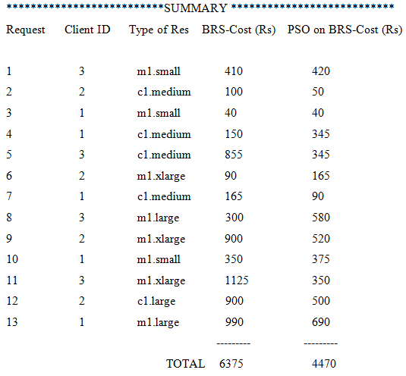
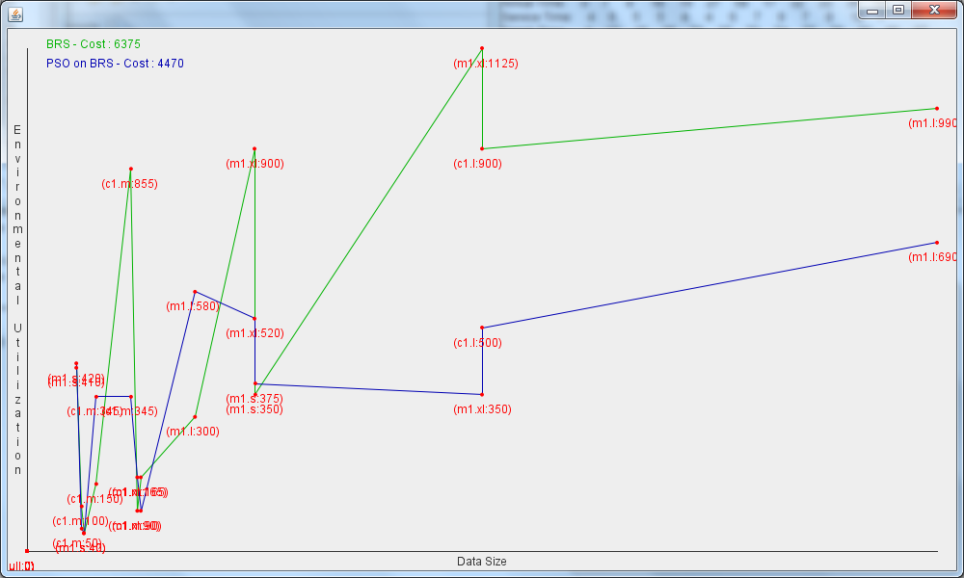
Comparison of Costs…

Slide 24
Thank you

